Slide 1
Natural Language Processing in Business Analytics

Slide 2
Overview
NLP
Recurrent Neural Networks
Transformers
BERT

Slide 3
MOtivation
It's about teaching machines to understand, interpret, and generate human language, much like how humans do, albeit in a simplified and rule-based manner.
Source

Slide 4
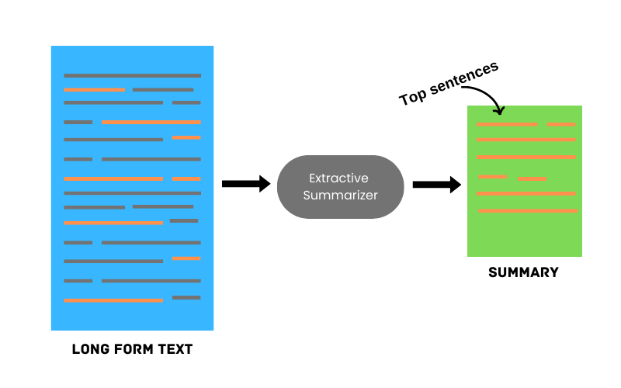

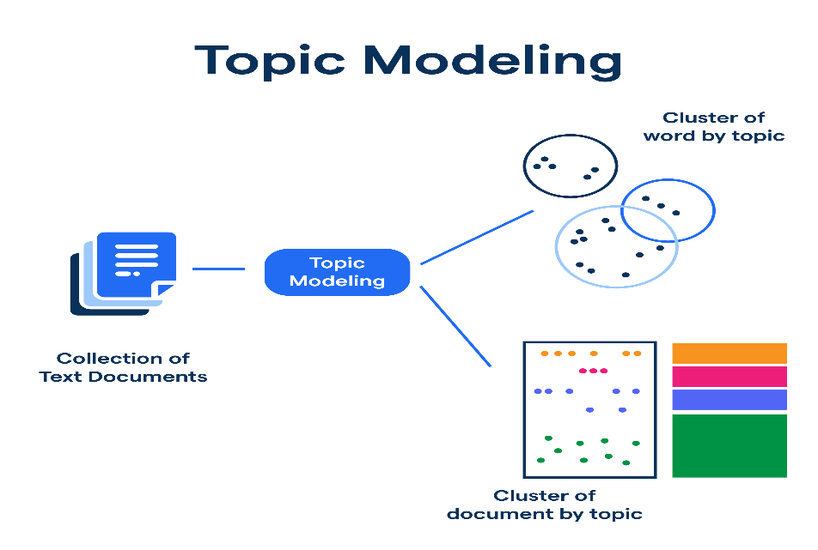
Applications in BA
Sentiment Analysis
Text Summarization

Slide 5

Language MOdelling
I am __________
BATMAN
Language Modelling

Slide 6
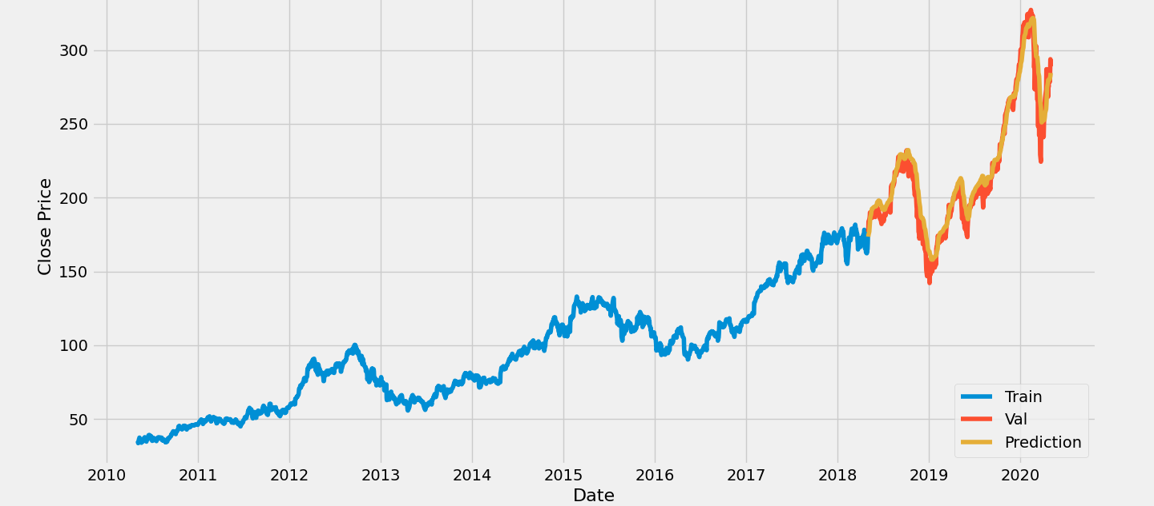

Why, How ?
Language Modelling has similar objectives as timeseries forecasting.
Predict the future, from the past.
$${ x}_{1 },…,x_{t−1} →{ x}_{t}$$

Slide 7



Why, How ?
Any time series follows a joint probability distribution where each state depends on past observations.
$$P\left(x_{1},x_{2}, .. . ,x_{T}\right)= \prod_{t=1}^{T}{P\left(x_{t}\right|{ x}_{t−1 },…,x_{1})}$$
Language models use this formulation to predict the next word, forming the basis of autoregressive models.
$$\left[\text{The},\text{weather}, \text{is}, \text{pleasant}, \text{today}\right]$$
$$P\left(The∩weather∩is∩pleasant∩today \right)$$
$P\left(The\right) P\left(weather|The\right)P\left(is | weather, The\right)$ $P\left(pleasant | is, weather, The\right)$ $P\left(today | pleasant, is, weather, The\right)$

Slide 8
Why, How ?
Good

Slide 9
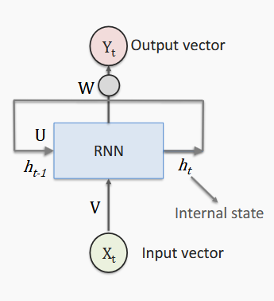
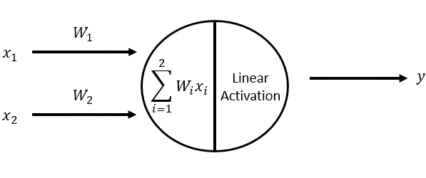
Recurrent Neural Networks
They are stateful
 | X1 | X2
Data Point 1 | 5 | 1
Data Point 2 | 2 | -1
Do not have information of previous data points

Slide 10
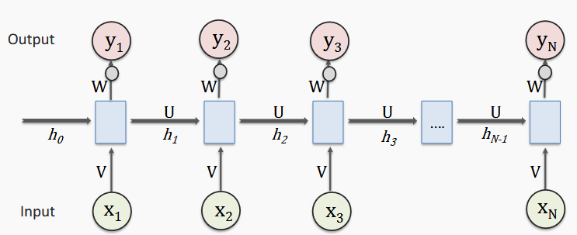
Recurrent Neural Networks
The hidden state keeps track of the context and enables the model to use it and predict the future.
W, U, V are parameters of the model that are shared across the whole sequence/sentence.

Slide 11

Recurrent Neural Networks
$$X=\left[\text{The},\text{weather}, \text{is}, \text{pleasant}, \text{today}, \text{Adil}\right]$$
$$Y=\left[\text{weather}, \text{is}, \text{pleasant}, \text{today}, \text{Adil}\right]$$

Slide 12
Recurrent Neural Networks
Hidden State / Memory

Slide 13
Recurrent Neural Networks
The
weather
The

Slide 14
Recurrent Neural Networks
The
weather
is
The
weather

Slide 15
Recurrent Neural Networks
The
weather
is
pleasant
The
weather
is

Slide 16
Recurrent Neural Networks
The
weather
is
pleasant
today
The
weather
is
pleasant

Slide 17
Recurrent Neural Networks
The
weather
is
pleasant
today
Adil
The
weather
is
pleasant
today

Slide 18
Recurrent Neural Networks
The
weather
is
pleasant
today
Adil
EOS
The
weather
is
pleasant
today
Adil

Slide 19
What’s Wrong ?
Fails to model long sequences
The process can’t be parallelized

Slide 20
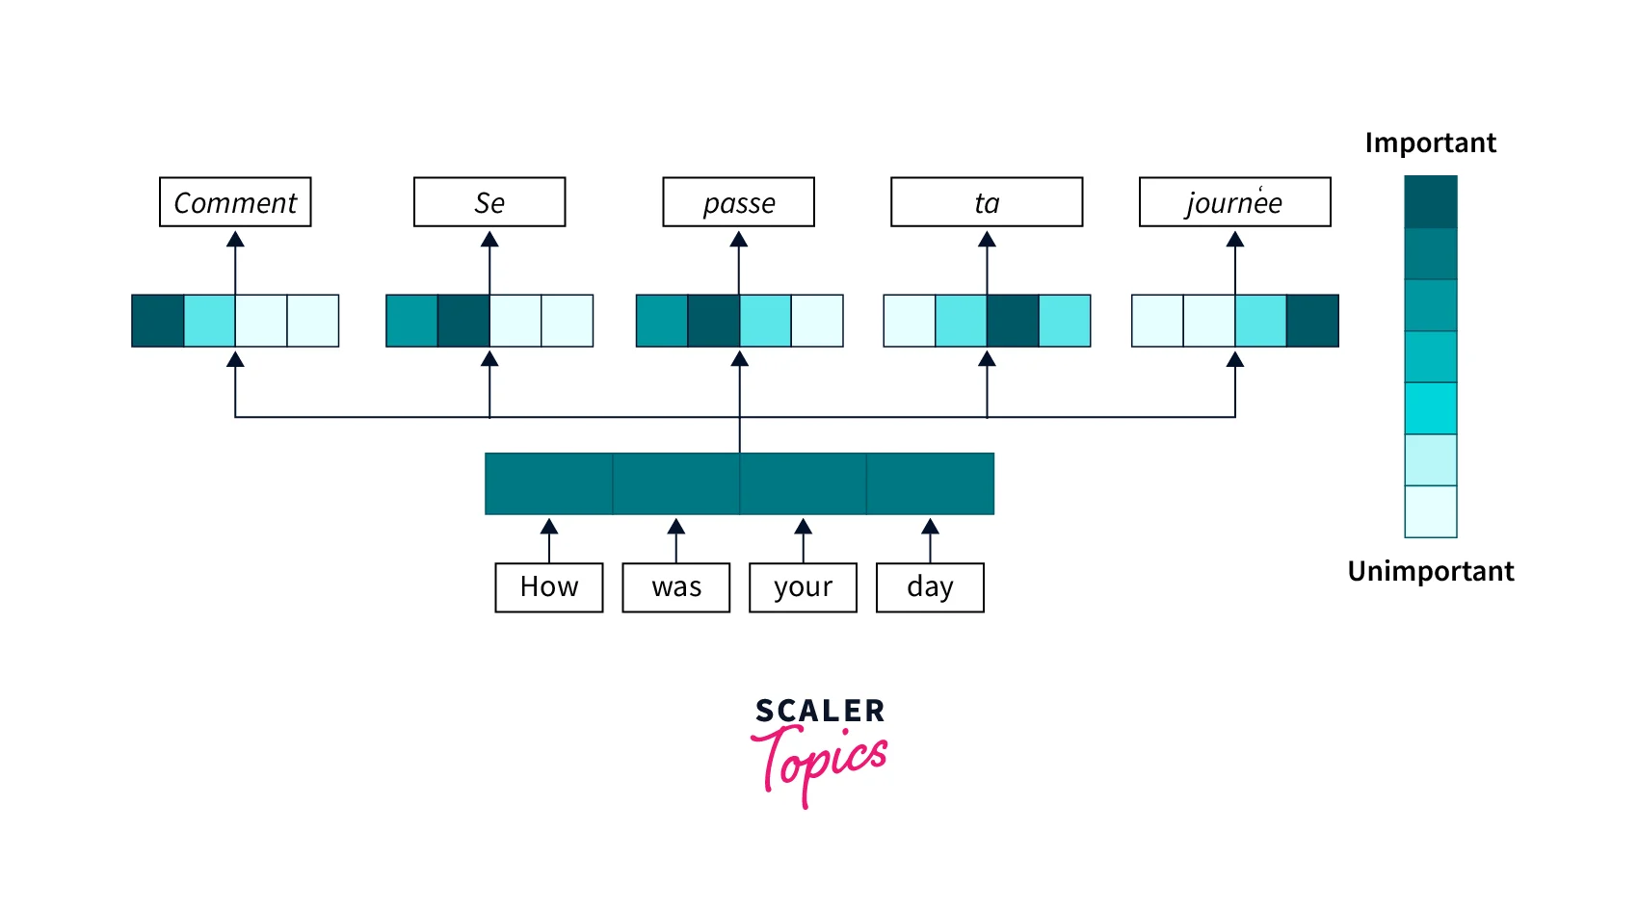
Attention
Source
Notes:
Attention is a measure of relevance.

Slide 21

Self Attention
It is a technique to determine which words in a sentence are most relevant to each other when processing a text sequence.
The cat sat on the mat because it was tired.
Reference to the cat or the mat ?

Slide 22
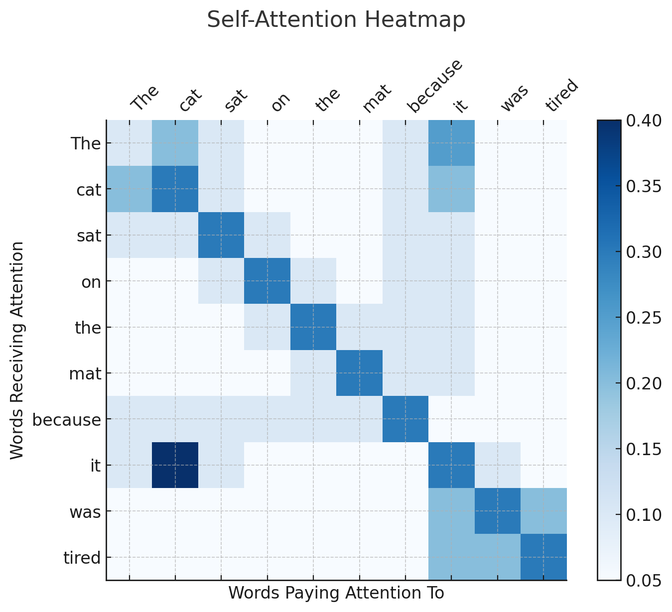
Self Attention

Slide 23
Transformers
Le chat dort
Encoder
Decoder
The cat sleeps

Slide 24
Transformers: Encoder
Encoder
Converts input words into contextual representations.
Uses self-attention to understand relationships between words.
Example: In "The cat sat on the mat," it understands that “The" relates to "cat."

Slide 25
Transformers: Encoder
Decoder
Takes the encoder’s output and generates new text step by step.
Uses cross-attention to focus on relevant words from the input.
Example: When translating "The cat sleeps" → "Le chat dort," the decoder focuses on "cat" → "chat" and "sleeps" → "dort."

Slide 26
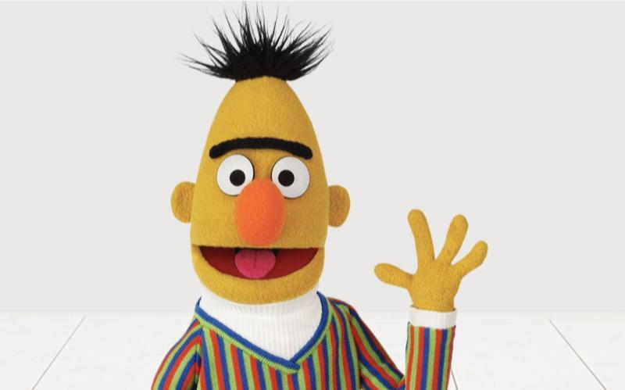
BERT: Bidirectional Encoder Representation from Transformers
BERT is a transformer-based NLP model developed by Google in 2018.
It is solely based on the encoder of the transformer architecture.
Unlike previous models that read text left-to-right (like RNNs) BERT reads in both directions simultaneously.

Slide 27
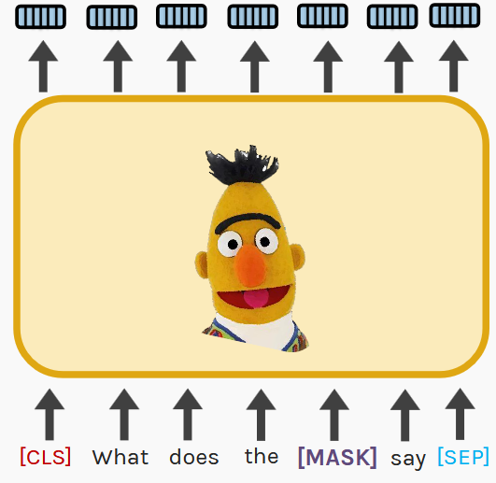
BERT: Bidirectional Encoder Representation from Transformers
Encoder
Uses context from both directions to predict [MASK]

Slide 28
The Pipeline
Sentences
Padding
Tokenization
Text Vectorization
Model

Slide 29
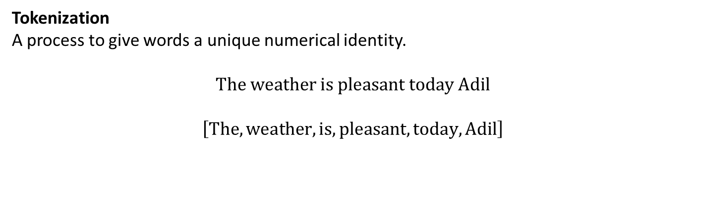
Important Concepts for Tutorial
Tokenization
A process to give words a unique numerical identity.
$$\text{The} \text{weather} \text{is} \text{pleasant} \text{today} \text{Adil}$$
$$\left[\text{The},\text{weather}, \text{is}, \text{pleasant}, \text{today}, \text{Adil}\right]$$
1 2 3 4 5 6

Slide 30
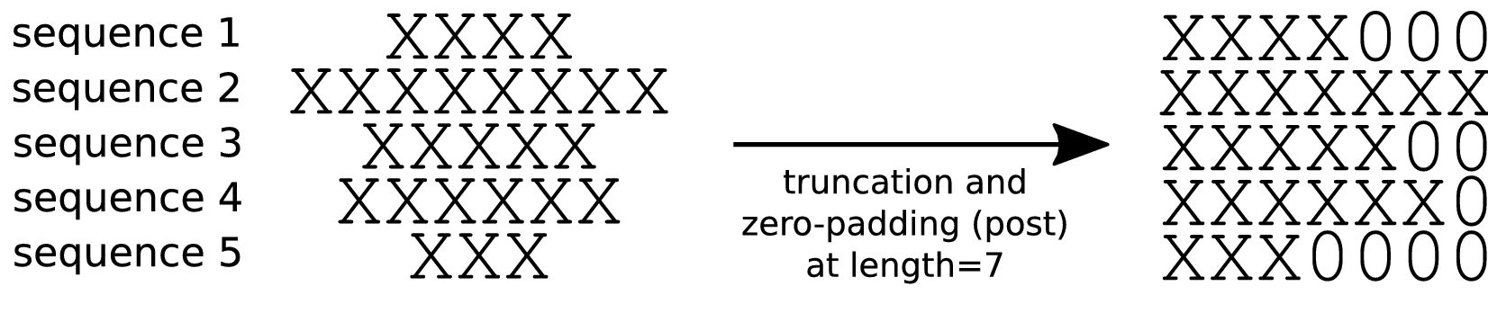
Important Concepts for Tutorial
Padding
Not all sentences are of equal length. Padding helps to build consistency in length by adding zeros at the start or end of the sentences to make them of equal length.

Slide 31
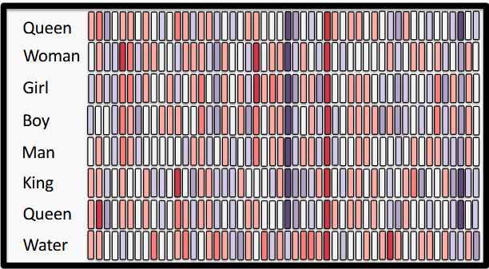
Important Concepts for Tutorial
Text Vectorization
A process to convert tokens to n-dimensional vectors.
Values of vectors are learnt at training time

Slide 32
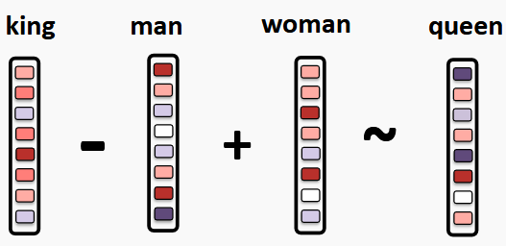
Important Concepts for Tutorial

Slide 33
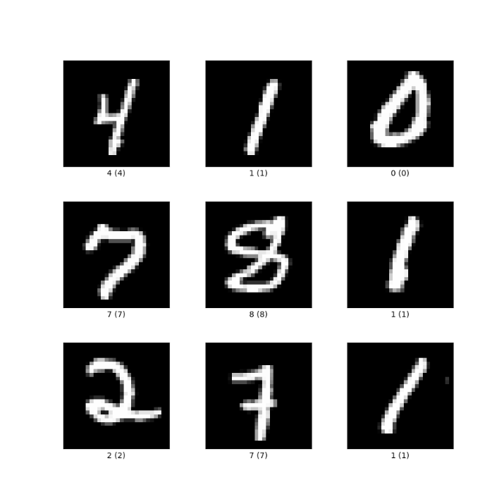
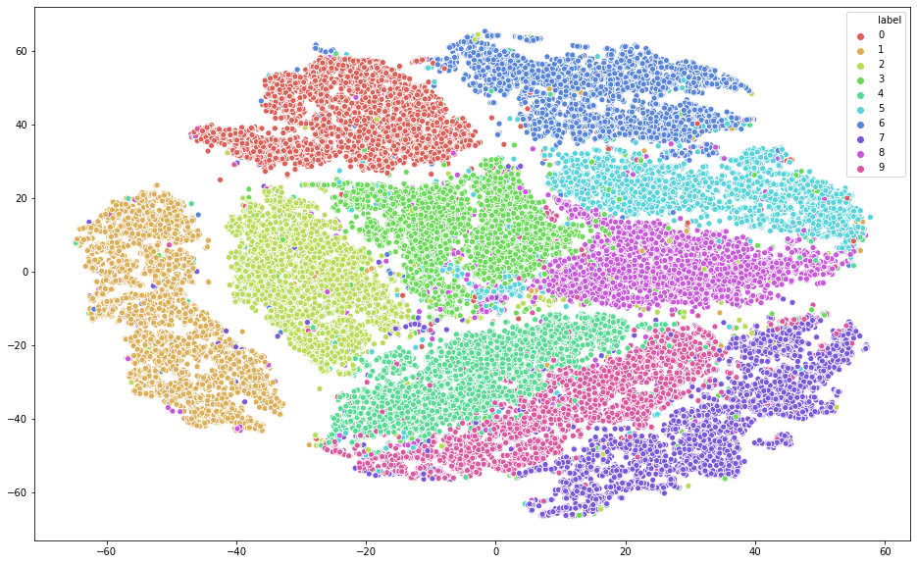
Important Concepts for Tutorial
Dimensionality Reduction
These are techniques that help us to map our text embeddings/vectors from a high dimensional to a lower dimensional space with minimal loss of information.

Slide 34
THANK YOU

